Slide 1
Validity

Slide 2
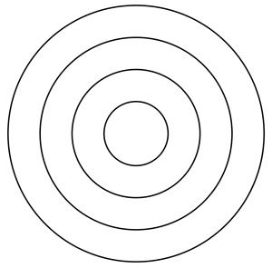
Validity (and its relation with reliability)
Validity – the extent to which scores from a measure actually represent the variable they are intended to.
Can be independent from reliability
An extreme example: using someone’s height to measure attention span. Reliable? ☺ Valid?
High Reliability. Low Validity
Low Reliability. Low Validity
Low Reliability. High Validity
High Reliability. High Validity

Slide 3
Face Validity
Face validity – the extent to which a measurement method appears on its “face” to measure the construct of interest.
Finger-length ~X~ self-esteem
Beck depression inventory ~=~ depression
You can measure face validity quantitatively (have a sample of people rate how much it appears to measure one thing)… but most of the time face validity is assessed informally.
Another note on intelligence tests…. (sorry).

Slide 4
Content Validity
- the extent to which a measure “covers” the construct of interest.
Different from face validity. Face validity is superficially what it appears to measure, and content validity think more so trained professionals identifying specific items, or specific correspondence with items and “symptoms”.
Depression
Might lack content validity if it addresses one facet of the construct, but not all of them. (affective dimension, behavioral dimension, both?)

Slide 5
Criterion Validity
- extent to which people’s scores on a measure are correlated with other variables (criteria) that one would expect them to be correlated with.
Measure of test anxiety – should be correlated (negatively) with actual test performance.
Criterion can be anything one has a reason to think should be correlated with the construct being measured.
Concurrent validity – when the criterion is measured at the same time as the construct.
Predictive validity – When the criterion is measured after the construct is measured.
Scores on a depression scale might be related to the number of times those same people report leaving their house (concurrent). Scores on a depression scale might be able to predict future occurrences of social interactions (predictive).

Slide 6
Discriminant validity
- the extent to which scores on a measure are not correlated with measures of variables that are conceptually distinct.
Self-esteem vs mood
Self-esteem is a general attitude towards the self – this is stable over time. This is different from mood that varies over time.
Self-esteem should not highly correlate with mood. If it does, it could be argued that your measure isn’t really measuring self-esteem, but mood.
Convergent validity – similar in concept to discriminant validity, but is the extent to which your measure does correlate with other similar measures of the same construct.

Slide 7
Wrapping up psychological measurement
Conceptually define the construct
Operationally define the construct
Implement the measure
Evaluate the measure
Other aspects of measurement
Sensitivity and range effects.
Make sure your measure is sensitive and measured in the right range.
Try and avoid “ceiling” and “floor” effects, where there is no room for participants to improve or decline over time.

Slide 8
Be able to…
Define and distinguish the different types of validity (and reliability from previous videos)
Be able to read scenarios and be able to tell if something has high or low reliability or validity of some kind

